Slide 1
Applied SAS Industry Training

Slide 2
CHAPTER 1: Biggest myths
Myth 1: Programming is difficult because it takes an advanced way of thinking to accomplish.
  Truth: People struggle because they don’t realize how “dumb” a computer is. Simply dumbing yourself down goes a long way to being a great programmer.

Slide 3
CHAPTER 2: Intro to SAS
A SAS program is a series of steps.
Each step takes your data from one form to another until you can use the data for analysis.

Slide 4
CHAPTER 2: Intro to SAS
95% of all SAS is broken down into 2 types of steps:
  DATA steps
  PROC steps

Slide 5
CHAPTER 2: Intro to SAS
DATA steps allow you to:
  Change variables from one form to another
    Numeric to character and vice versa
  Merge and combine data sets
  Create new variables either on their own or from mathematical functions of other variables:
    Profit (the new variable) = total_revenue – total_cost
  And Many more….

Slide 6
CHAPTER 2: Intro to SAS
PROC steps allow you to:
  Use SQL methods to:
    Merge, sum, take averages, count, etc… from data
  Perform Statistical analysis
  Create graphs and other visual displays
  Etc…

Slide 7
CHAPTER 2: Intro to SAS
So what’s the difference then????
  Little, SAS is a very flexible language which means there are countless ways to do something.
  Both DATA steps and PROC steps will get you from A to B when it comes to data manipulation but all analysis and graphs are done with PROC steps.
  Yet, DATA steps are unique for also allowing you to make a dataset from either raw data or from scratch.

Slide 8
CHAPTER 3: Making a Data Set
A dataset is just like a spreadsheet. You fill it with information and then perform operations on it.

Slide 9
CHAPTER 3: Making a Data Set
So how do you make one?
Use a Data Step!
Of Course, this dataset is empty. We need to fill it with something between the ‘data’ statement and the ‘run’ statement.
data profit; /*creates a data set named ‘profit’ */
run; /* tells SAS to finish creating the dataset */

Slide 10
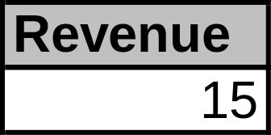
CHAPTER 3: Making a Data Set
Lets add some info to dataset ‘profit’.
Add a variable called ‘revenue’ and set it equal to 15.
data profit; /*creates a data set named ‘profit’ */
revenue=15; /*creates a variable named ‘revenue’ and assigns a value to it */
output; /* Tells SAS to output the previous variable into the dataset */
run; /* tells SAS to finish creating the dataset */
Output ==>

Slide 11
CHAPTER 3: Making a Data Set
The previous output might have looked similar to Excel, and that’s because it is!
  End results are the same
To make sure the intuitive understanding is there lets look at how you would get the same results from Excel and from using the Data Step in SAS.

Slide 12
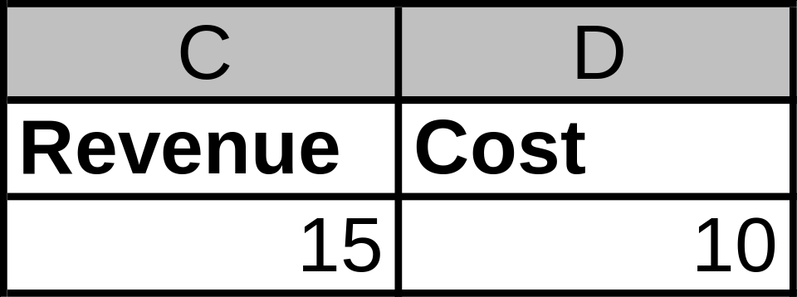
CHAPTER 3: Making a Data Set
In Excel you might want to calculate profit. So first you add the variables Revenue and Cost to the Excel sheet as seen below.

Slide 13
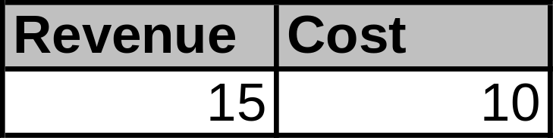
CHAPTER 3: Making a Data Set
In SAS you will use the DATA step to create a dataset named “Profit” with the same two variables: Revenue, and Cost. And you say what values Revenue and Cost will be just like Excel.
data profit; /*creates a data set named profit */
Revenue=15; /*creates a variable named Revenue and sets it equal to 15*/
Cost=10; /*creates a variable named Cost and sets it equal to 10 */
output; /* Tells SAS to output the previous variables into the dataset */
run; /* tells SAS to finish creating the dataset */
Output ==>

Slide 14
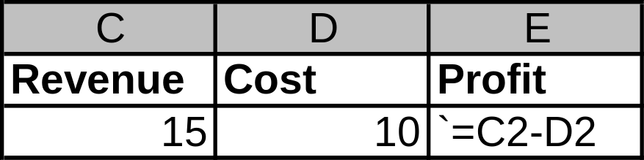
CHAPTER 3: Making a Data Set
Now that we have Revenue and Cost it’s time to calculate Profit. In Excel it looks:

Slide 15
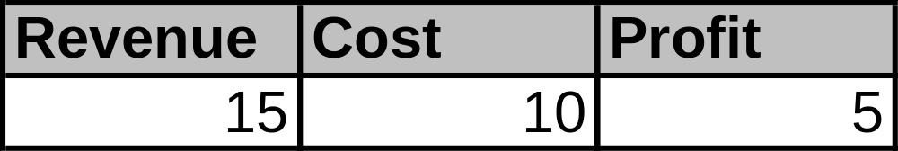
CHAPTER 3: Making a Data Set
Likewise in SAS:
data profit; /*creates a data set named profit */
Revenue=15; /*creates a variable named Revenue and sets it equal to 15*/
Cost=10; /*creates a variable named Cost and sets it equal to 10 */
Profit=Revenue – Cost;
output; /* Tells SAS to output the previous variables into the dataset */
run; /* tells SAS to finish creating the dataset */
Output ==>

Slide 16
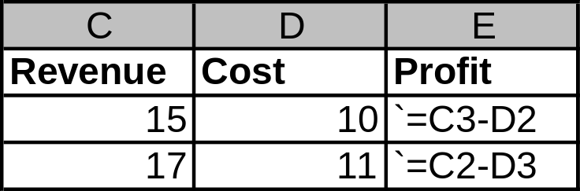
CHAPTER 3: Making a Data Set
Now it’s time to add a second row. In Excel it’s just typing in another row under the previous.

Slide 17
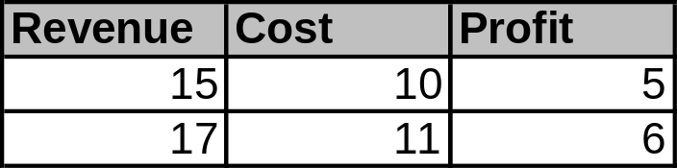
CHAPTER 3: Making a Data Set
In SAS, we need to dumb things down and tell the program to add to the next line using an additional ‘output’ statement after adding the next row of values.
data profit; /*creates a data set named profit */
Revenue=15; /*creates a variable named Revenue and sets it equal to 15*/
Cost=10; /*creates a variable named Cost and sets it equal to 10 */
Profit=Revenue – Cost;
output; /* Tells SAS to output the previous statements to a dataset */
Revenue=17;
Cost=11;
Profit=Revenue-Cost;
output; /* Tells SAS to output the statements since last ‘output’ to next row */
run;
Output ==>

Slide 18
CHAPTER 3: Try on your own
Create a dataset called: Loans
Make 3 rows of the following info respectably:
  Customer: David, Ashley, Mike
  Product: HEIL, MTG, LOT
  LoanAmt: 50000, 100000, 90000
  Appraisal: 65000, 112000, 75000
  LTV (Loan to Value) for each
  Hint1: Use “/” for division: LTV = Loan/Appraisal
  Hint2: Use “ ” for entering character values: Customer=“Mike”
  Hint3: Do NOT use commas or any character other than numeric when entering numbers.

Slide 19
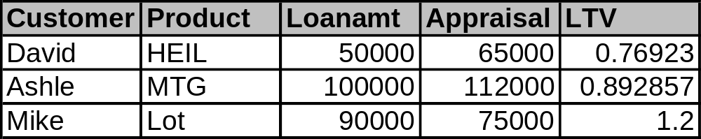
CHAPTER 3: Try on your own
(Result)
Output ==>
Everything looks good, except poor Ashley is now just an Ashle
One vital part of creating variables is left:
The "Format" statement!

Slide 20
CHAPTER 4: Variable manipulation
There are many ways to manipulate the way variables, and data in general appear and behave.
Lets look at how to use the ‘Format’ statement with the ‘Try on your own’ exercise.

Slide 21
CHAPTER 4: Variable manipulation
Try yourself Solution
data Loans;
Customer="David";
Product="HEIL";
Loanamt=50000;
Appraisal=65000;
LTV=loanamt/appraisal;
output;
Customer="Ashley";
Product="MTG";
Loanamt=100000;
Appraisal=112000;
LTV=loanamt/appraisal;
output;
Customer="Mike";
Product="Lot";
Loanamt=90000;
Appraisal=75000;
LTV=loanamt/appraisal;
output;
run;
Now what we should have done is to tell the program more about the Variables before we stuck values in them. We use a ‘Format’ statement for that and stick it above the variables.
format Customer $7.
Product $5.
Loanamt dollar12.0
Appraisal dollar12.0
LTV percent8.1;

Slide 22
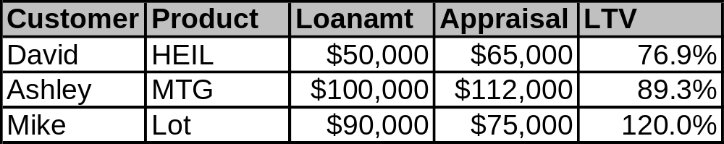
CHAPTER 4: Variable manipulation
data Loans;
format Customer $7.
Product $5.
Loanamt dollar12.0
Appraisal dollar12.0
LTV percent8.1;
Customer="David";
Product="HEIL";
Loanamt=50000;
Appraisal=65000;
LTV=loanamt/appraisal;
output;
Customer="Ashley";
Product="MTG";
Loanamt=100000;
Appraisal=112000;
LTV=loanamt/appraisal;
output;
Customer="Mike";
Product="Lot";
Loanamt=90000;
Appraisal=75000;
LTV=loanamt/appraisal;
output;
run;
‘$7.’
after Customer says the value can be up to 7 characters long, plenty for poor Ashley.
‘$5.’
after product means the value can be up to 5 characters long.
‘dollar12.0’
after Loanamt and Appraisal says values should look like currency with a dollar sign and can be 12 characters long (including dollar sign and commas and decimal point) and 0 characters after the decimal point.
‘percent8.1’
after LTV says values should be in percents, at most 8 characters long (including decimal point and percent (%) sign with only one character after the decimal point.
Output

